Slide 1
TYPES AND FORMS OF REPORTS
LONG AND SHORT REPORTS
FEASIBILITY REPORT
INVESTIGATIVE REPORT
PROGRESS REPORT
AUDIT REPORT
STAFF REPORT
CONFIDENTIAL REPORT
TECHNICAL REPORT
EVALUATION REPORT
NEWS PAPER REPORT
BLANK FORMAT REPORT
LETTER REPORT
MEMORANDUM

Slide 2
LONG AND SHORT REPORTS
A short report being more a part of the routine official work , it can be sometimes a little more personal in tone, while longer report preserves an impersonal tone.

Slide 3
FEASIBILITY REPORTS
When a firm or a business establishment intends to start a new venture or to open a new branch as to effect any other change to avoid losses and increase profit , a feasibility report in written. A feasibility report helps us
To determine whether a proposed scheme would be practicable and profitable or not. Feasibility report consists of these parts: introduction , body , conclusion and recommendation. The introduction describes the condition which have necessitated the proposed change or improvement. It also defines the scope of a report.

Slide 4
FEASIBILITY REPORTS
The body forms an answer to the problem stated in the introduction. It also discusses all the alternatives , out of which the best solution is to be chosen. It evaluates each of the answers in accordance with its merits and demerits. The conclusion contains the opinion of the author of the report on the worth of the alternatives available. It tries to compare the degree of feasibilities of different plans, and gives them a proper order. The recommendation is the last sentence that recommends the best alternatives.

Slide 5
Below are the seven elements of a feasibility report:
Introduction – You need to persuade the decision maker to even consider any sort of alternative. You need to convince them to even read your report first. Tell them what they will gain personally or as an organization by considering your work.
Criteria/Constraints – You must specifically map out the criteria of what the ideal outcomes are. This will allow you to make practical and logical decisions. You can present the criteria in your feasibility report in one of two ways. First, you can separate the criteria into its own section. This is best when you have a extensive report and you need to go in-depth with the explanation. Second, you can incorporate the criteria throughout your report as the criteria become relevant. However, it is important to realize that whichever strategy you chose make sure that the criteria is introduced early in the report. It is also very important to map out the constraints of your suggested solutions. This will show the audience that you understand and acknowledge the fact that no solution is perfect. This will also make sure that the audience makes the decision in their best interest.

Slide 6
Method – It is very important to present facts that are accurate and relevant. You should state the reliable sources you used and what method they came from (internet, interview, book, etc.). Without a credible research method or credible sources your document itself will lack credibility.
Overview of Alternative Options – You must underline the key features of each possible option. Make sure they are easy to understand and presented in a friendly layout. Keep in mind that the goal is to allow your audience to make the best decision.
Evaluation – This should be the bulk of your report, you must evaluate the options using the criteria you created. Add graphs, charts, etc. to show that you have studied your options, and have come up with statistics that back up your reasons as to why your alternative beats the competition.

Slide 7
Conclusions – You need to state the conclusion you have came up with. How did you evaluate the alternatives? And then from there, which alternative best fit your organization.
Recommendations – You need to use your experience and knowledge in order to state which option you think should be adopted.
Note: All seven element outlined do not need to be included in the feasibility report depending on audience, circumstance, mission, etc. Also the elements do not need to be in the exact order outlined above. Specifically the conclusion should be mentioned more than just at the end of the report. It should also be summarized in the beginning of the report and in the case the the feasibility report is long, it can be mentioned in the middle as well.

Slide 8
Executive Summary
An executive summary should be included at the beginning of the report. In 2-3 pages, the main points of the feasibility study are summarized for a quick review by busy administrators and school board members. The executive summary provides the reader with an overview of the feasibility study and will help them see the entire picture before they read the details. Some decision-makers may only read the executive summary. Thus, the executive summary should be concise and include the major findings of the study followed by a recommendation.

Slide 9
Introduction
The purpose of the introduction of a feasibility report is two-fold:
To answer the readers’ question: “Why do we need to look into these alternatives-do they matter?”
In order to answer this question, it is necessary to identify the problem that your report will help resolve or what your report is aimed at accomplishing.
To talk about the other options that you have looked at and analyzed, as well as to tell how you went about researching and analyzing them.

Slide 10
Criteria/Constraints
What to consider in your feasibility study/report. As you begin formulating what you would like to consider you should realize that usually criteria works around one or more of the following questions.
Will your plan or course of action really do what is desired?

Slide 11
What will it take to implement your course of action?
Even though your plan of action may seem correct and efficient on paper, it may not be practical towards your line of work. You must take into account the circumstances that arise in every aspect of a professional setting. What you may find is that in one field your plan may be extremely successful, but in another may be a bust. This can also take place from company to company. As you work at different companies along the same field, you will begin to understand what can be successful in one workplace that may not work in another.

Slide 12
Cost of Implementation
This may become the biggest factor in any business decision. How much will it cost? In not only business, but any professional field, the benefits must outweigh the costs in any decision. This is even the case when deciding to work on one aspect of a project compared to the other. When forming criteria for a feasibility report, you must understand the costs if all went as planned. Then you might even want to find out what the cost would be if you had minor or major setbacks. It is important to understand the costs because unless the benefits outweigh the costs, a company will most likely not go through with your proposed plan of action. Also it is important to look into the future of the company.

Slide 13
Is your idea/product desirable?
This is as simple as is your plan going to sell. Will people want to overextend themselves for change, or will they reject what you are trying to do? Sometimes a change or solution must be more than just effective and affordable. You must consider the consumers and people that will be changing. Sometimes many feasible courses of action do not succeed simply because they create effects that drive the consumers away. Because of this, the product or plan does not sell. These undesirable side effects can be as simple as tearing away employee morale.

Slide 14
Method
Things to keep in mind:
This section of your feasibility report is one of substantial magnitude and importance. This part of your paper demonstrates to the reader what you discovered, through your research, actually matters and has reliability. By telling your audience how you came to know what you have found out and know now, you are demonstrating to them that your results are trustworthy and that they truly hold significance in meaning. With strong methods for finding out your facts, your readers will then feel comfortable and confident to make the necessary changes.

Slide 15
Revision Checklist
Once your feasibility study is complete analyze the checklist to ensure every topic has been addressed.

Slide 16
Investigative Report
An investigative report is prepared to find out certain facts in a specific context . It might be an analysis of the things actually happened or an enquiry into the cause behind the situation. An investigative report would begin with an introduction to the background of the report. Its body consists of the listening of the findings.

Slide 17
PROGRESS REPORT
A progress report is written to communicate the state of a project or scheme already in progress. Some of the business or technical activities are of such nature as to require a long period of time before they reach competition. The directors or the managers, who has assigned that work to any company etc., would like to be periodically informed, be it weekly, fortnightly, monthly or annually , about the developments. They may as well ask an employees or a team of the employees, to access and report the state of work-how much work has been done, how much is yet to be done.

Slide 18
AUDIT REPORT
An audit report is a comment on the financial records or accounts etc. of an organization.
While short –form audit reports consist of conventional, standardized statements, long form audit reports can be presented in several forms.

Slide 19
STAFF REPORT
It begins with the information regarding the person by whom and for whom the report is being written and the data etc. An executive summary is often placed first, as perusal of the entire report is generally not possible for the busy authorities. The rest of the report is conventionally structured, having a discussion of the problems and conclusions and recommendations.

Slide 20
CONFIDENTIAL REPORT
These reports are secret documents in which the higher authorities express their opinions on the performance of the employees working under them.

Slide 21
TECHNICAL REPORT
As the name suggests, a technical report contains a discussion of the method and processes relevant to that problem. It would give details of the suitable opinions, facts about their comparative worth, and a statement of preference for the best solution.

Slide 22
EVALUATION REPORT
An evaluation report evaluates the process of the project. It is an exercise to study the performance of a plan. Such reports must define the standard by which the working of a project is to be tested and its achievements are to be measured. It should see how far the plan has been responsive to the projected goal, and why it has fallen short of it , if it happens to be so.

Slide 23
NEWSPAPER REPORT
A newspaper report is a major part of the journalistic writing .Newspaper reports are written for public consumption. Therefore ,these must be written in a language and style suitable for the awareness which such reports are expected to create among the readers. A newspaper report would be justified only when its subject is of some general interest.

Slide 24
BLANK FORM REPORT
A blank form report is so called for it is in the form of a prescribed form. It is routine report, periodically presented by simply filling the form.

Slide 25
LETTER REPORT
A letter report resembles a business letter to some extent , for it is in the form of letter. It is often a little more personal in tone than a formal report. We can make a letter report more readable by presenting the facts clearly and systematically . Using points to list the findings and the suggestions is one of the ways to make letter reports more effective.

Slide 26
MEMORANDUM
A memorandum report , commonly known as memo report , is mainly used for internal communication , that in within the organization . It is used to handle routine business matters like passing information from one department to another, making changes , alerting employees , solving a problem etc. It helps the administration in making decisions as solving certain problems. Generally, a memo report is shorter than a letter report and adopts a matter-of-fact style.

Slide 27
FORMAT OF REPORT
NAME OF ORGANISATION/INSTITUTION
TO: REF. :
FROM: DATE:
SUBJECT:
POINTS DISCUSSED/STUDIED/OBSERVED/WORK DONE
------------------------------------------------------------------------
------------------------------------------------------------------------
RECOMMENDATIONS:
---------------------------------------------------------------------------
------------------------------------------------------------------------------

Slide 28
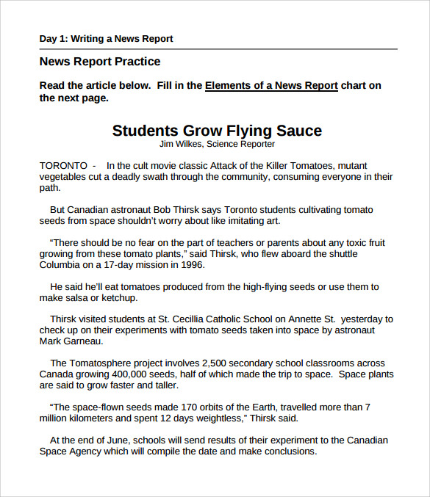
Sample News Paper Report

Slide 29
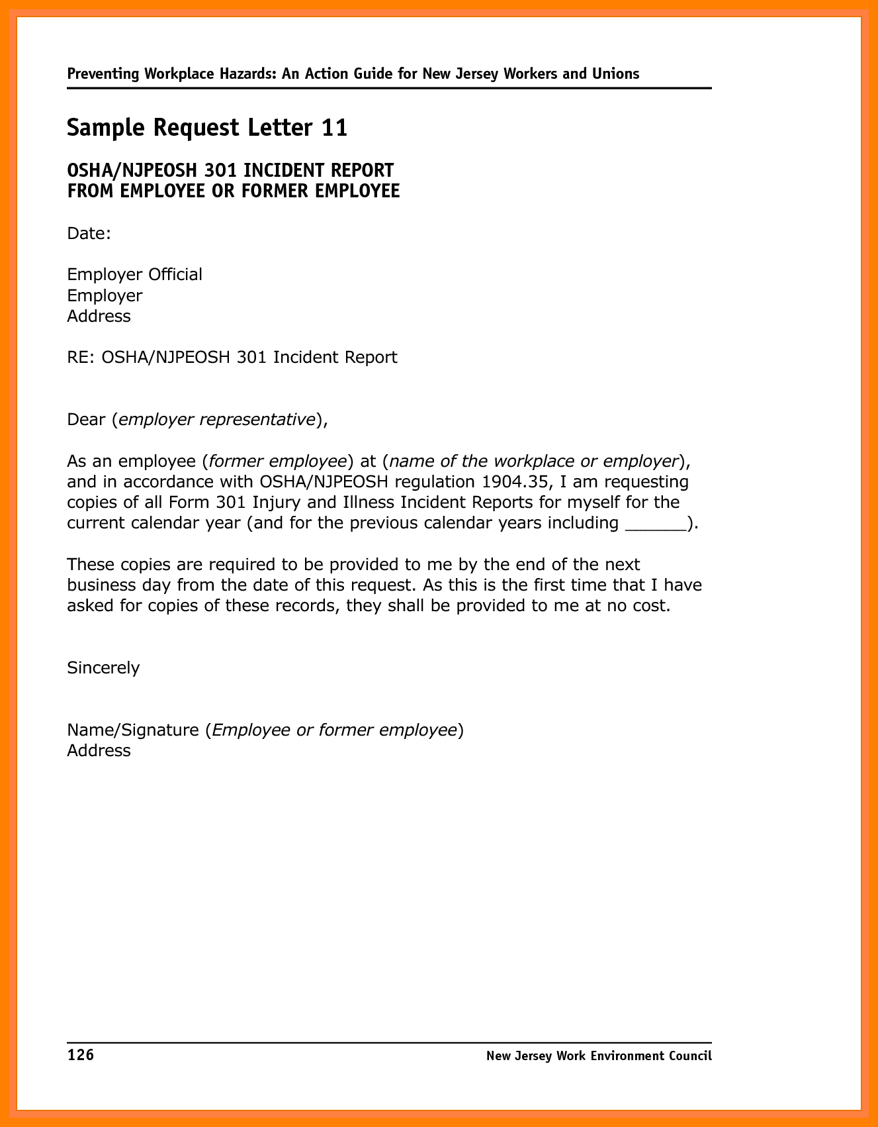

Slide 30
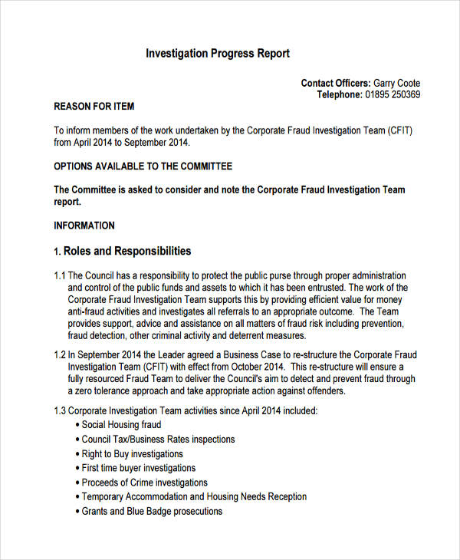

Slide 31
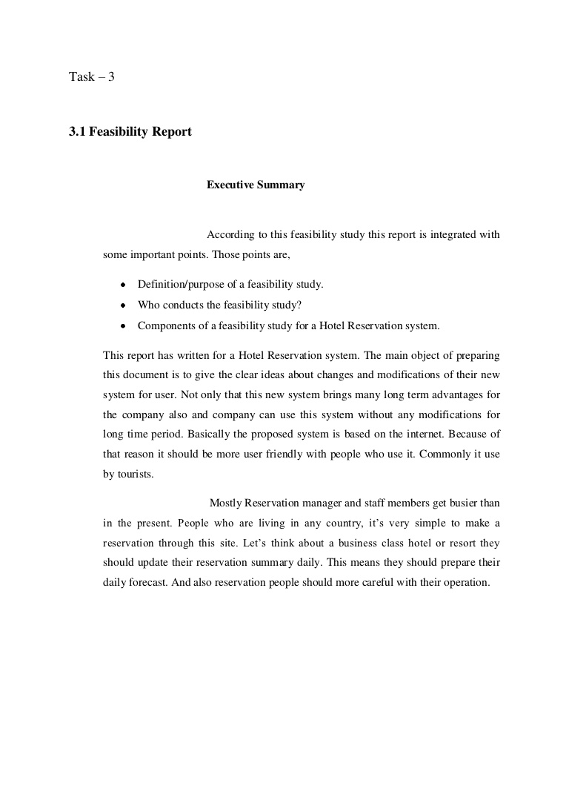

Slide 32
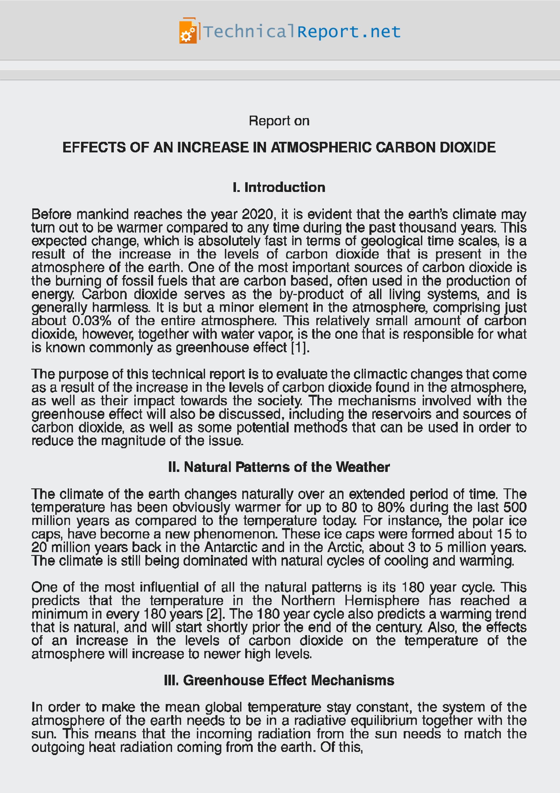

Slide 33


